Slide 1

FULL STACK DEVELOPMENT MINI PROJECT
Presentation By,
Harini L (1ST21CS073)
Harshitha K(1ST21CS078)
Harshitha V (1ST21CS081)
Monisha S R(1ST21CS125)

Slide 2

Online SHOPPING SYSTEM Mini-Project
Using Django

Slide 3
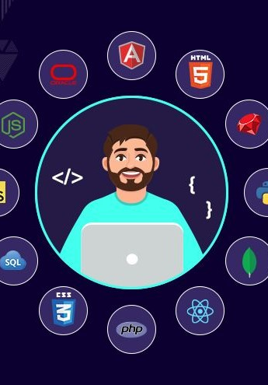
01
Introduction
About Full Stack Developement

Slide 4
Introduction to FSD
Full stack development involves creating both the front-end (client side) and back-end (server side) parts of a web application, ensuring it functions smoothly and cohesively from the user interface to the database and server logic.
Front-End Development:
User Interface (UI): Designing and building the visual elements that users interact with.
Technologies: HTML, CSS, JavaScript, and frameworks/libraries like React, Angular, or Vue.js.
Back-End Development:
Server-Side Logic: Managing application logic, database interactions, and server configurations.
Technologies: Server-side languages like Node.js, Python, Ruby, Java, or PHP, and frameworks like Express, Django, Rails, or Spring.
Databases: Working with databases such as MySQL, PostgreSQL, MongoDB, or SQLite.

Slide 5
Skills Required:
Versatility: Ability to work with different technologies and frameworks.
Problem-Solving: Strong analytical skills to diagnose and fix issues across the stack.
Collaboration: Working effectively with other developers, designers, and stakeholders to deliver a cohesive product.
Full stack development involves a comprehensive understanding and ability to handle all aspects of a web application, from the user interface to the server-side logic and database management.

Slide 6

02
Problem Statement
Project statement and Objectives

Slide 7
Problem Statement of the Project
In the current digital marketplace, there is a high demand for efficient and user-friendly e-commerce platforms.
However, many small and medium-sized businesses struggle to establish an online presence due to limited technical expertise and resources.
Existing solutions often lack the simplicity, customization, and security needed to meet both consumer expectations and business needs.
This project aims to address these challenges by developing a streamlined e-commerce website that provides an optimal shopping experience while being easy for businesses to manage.

Slide 8
Objectives
To deliver a easy and efficient buying experience.
Ensure a smooth and efficient checkout process to enhance user satisfaction.
Enable administrators to easily add, update, and delete products.
To ensure secure transactions and data protection.
Categorize products effectively for better user browsing and searching.
Offer a review and rating system for users to provide feedback on products and services.

Slide 9

03
Design
Components used for designing the project

Slide 10
Components used for designing the Project
For our Online Shopping System Mini-project we used some components to build the Web application.
Web Frameworks : - Django, Bootstrap(for CSS).
User Interface HTML(For page Layout design) and CSS for Front End and Python Django for Backend.
SQLite3 Database for store the data.
Integrated Development Environment (IDE) used for the development is V S Code.

Slide 11

04
Implementation
Live Demo of Mini Project

Slide 12
Implementation of Project
First we will Create Environment to execute the program.
Then we add a command to go for a Current Directory which project is present.
Then we will Run the project using Run Server command.
Then we will get the URL http://127.0.0.1:8000/ is a common address used in web development, especially when working with web frameworks like Django.
Then we can see or display our web application in the Browser
This is how we implement the Django project.
Live Demo will be Represented in VS code.

Slide 13
05
Advantages
Uses of the Project

Slide 14
Advantages
Streamlined Product Management: Easy product addition, updating, and deletion, with effective categorization for better browsing.
Improved Security: Secure user authentication, data protection, and safe payment processing.
Intuitive Interface: A user-friendly design ensures that customers can easily navigate the website, find products, and complete purchases
Online marketplaces often have lower operational costs compared to physical stores (e.g., no need for rental space).
Buyers can buy any products from the comfort of their homes, available 24/7.

Slide 15

06
Conclusion
Knowledge gained from this project

Slide 16
Conclusion of Project
The purpose of this project was to develop a web application and an android application for purchasing items from a shop.
Users enjoy the convenience of a 24/7 marketplace, competitive pricing, and a diverse range of products, leading to an improved shopping experience.
This project helped us in gaining valuable information and practical knowledge on several topics like designing web pages using html & css, usage of responsive templates, designing of android applications, and management of database using mysql .
By addressing common challenges faced by online retailers, this website ensures a user-friendly, secure, and efficient platform for both customers and businesses.

Slide 17
Thank You!

